Slide 1
Moodifier
Intensifies your current mood

Slide 2

Mission statement:
Android Application which will intensify your current mood. Whether you are happy, sad, angry, surprised, it will certainly try to boost your mood to a great extent.

Slide 3
GOALS
Emotions Detection
Primary goal of our project would be to detect emotion of an individual using Face Detection, Eye Tracking and specific facial positions.
Intensifying detected emotion Secondary goal will involve supplementing an individual’s detected emotion to a healthy mood!

Slide 4
How will Emotions recognised?
Emotive analytics is an interesting blend of psychology and technology. Though arguably reductive, many facial expression detection tools lump human emotion into 7 main categories: Joy, Sadness, Anger, Fear, Surprise, Contempt, and Disgust. With facial emotion detection, algorithms detect faces within a photo , and sense micro expressions by analyzing the relationship between points on the face, based on curated databases compiled in academic environments.

Slide 5
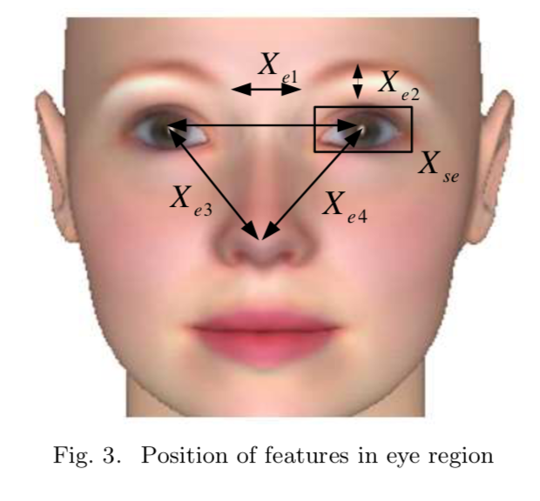
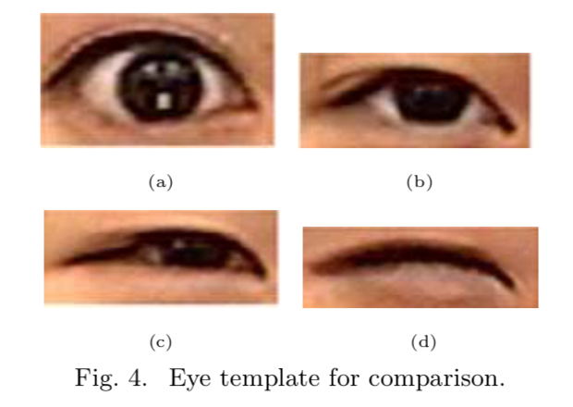
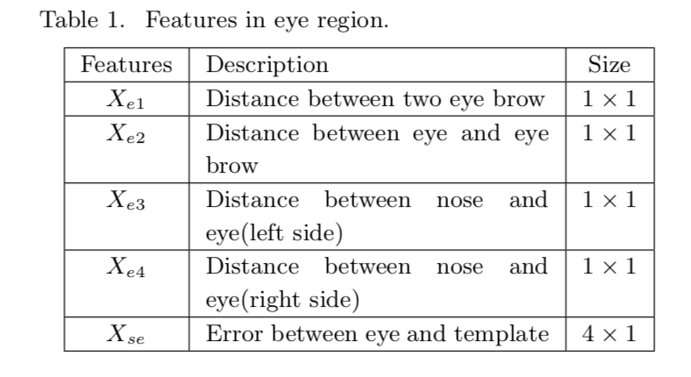

Slide 6
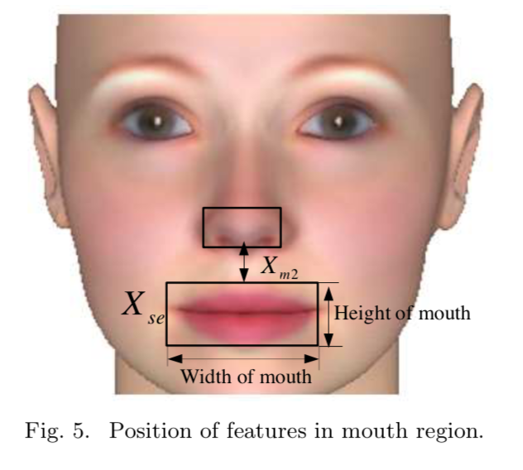
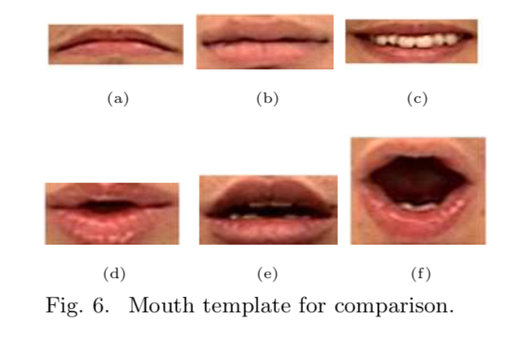
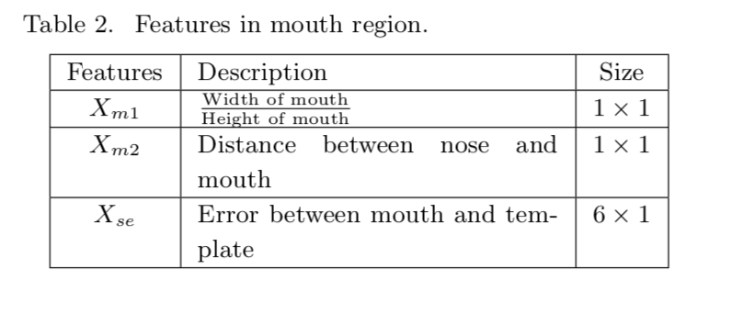

Slide 7
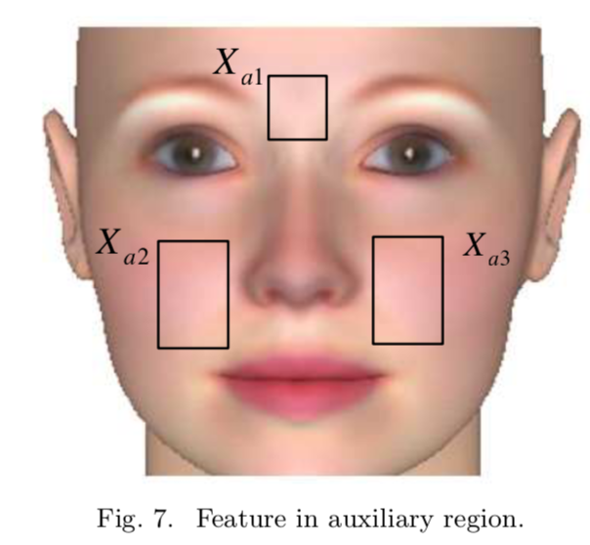
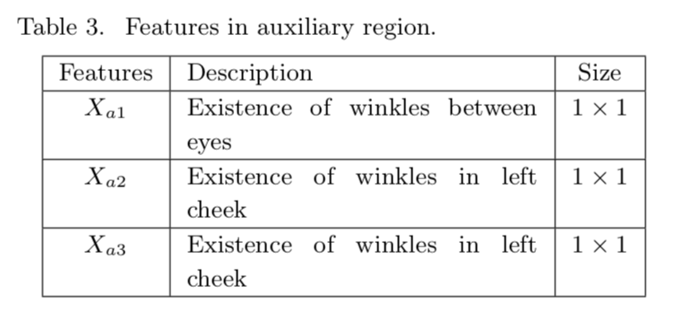

Slide 8
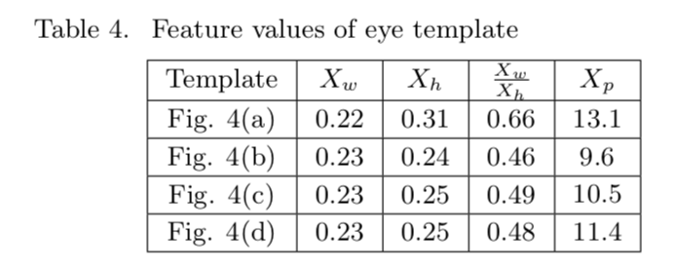
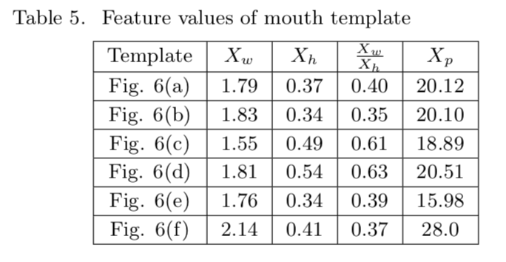

Slide 9
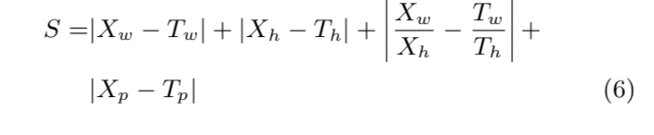
FORMULA USED

Slide 10
How will Moodifier works?
Step 3
Step 2
Step 1
Moodifier will provide certain platforms to achieve the same.
If online, User can click their image and it will start getting processed to detect emotions from this captured image.
User can select mood (offline) or can click on “I dont know” (online)

Slide 11

Technology Stack
Java Programming
XML for Layouts
Microsoft Cognitive API
Image Processing
Smart Animation Library
Android SDKs
Git/Github

Slide 12

Future Plans
Moodifier can be further extended by detecting emotions from user’s speech (Speech Tone Recognition).

Slide 13
References
https://azure.microsoft.com/en-in/services/cognitive-services/
https://developers.google.com/vision/face-detection-concepts
https://github.com/ratty3697/android-smart-animation-library
Emotion Detection Algorithm Using Frontal Face Image By Moon Hwan Kim¤, Young Hoon Joo¤¤, and Jin Bae Park
Others: Stackoverflow, etc

Slide 14

Thank You!!

